Slide 1

MANAGEMENT OF SMALL BUSINESS
Types of Enterprises in Ukraine

Slide 2
ENTERPRISE -
independent economic entity
created by the competent authority on
government or local government level, or other entities
to meet social and personal needs through the systematic implementation of production, research, trading, and other economic activities in the manner prescribed by the current legislation.

Slide 3
The enterprise is a legal entity,
which has:
separate property,
independent balance,
accounts in bank institutions,
a seal with its name and identification code.

Slide 4
Signs of classification of enterprises:
ownership,
size,
the way of formation and formation of the statutory fund,
legal form

Slide 5

By form of ownership:
private enterprises based on the private ownership of legal entities and individuals;
enterprises operating on the basis of collective ownership;
utilities operating on the basis of communal property of the territorial community;
state enterprises based on state ownership;
mixed, acting on the basis of association of property of different forms of ownership.

Slide 6
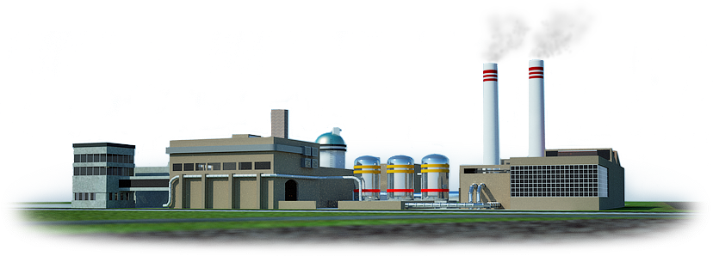
By size:
big,
medium,
small.

Slide 7


By way of forming a statutory fund:
unitary enterprises created by one founder,
corporate, formed, as a rule, by two or more founders in their joint decision.

Slide 8
By organizational and legal form :
joint-stock company;
limited liability company;
an additional liability company;
full partnership;
limited partnership.

Slide 9
Joint-stock company (JSC) -
a company with a statutory fund divided by a certain number of shares of the same nominal value,
and is responsible for the obligations only by the property of the company, and the shareholders bear the risk of losses associated with the company's activities, within the value of their shares

Slide 10
Limited Liability Company (LLC) -
business company,
which has a statutory fund
divided into shares, and is responsible
by its obligations only by its own property,
and the members of the partnership bear the risk of losses associated with the activity of the partnership, within their contributions

Slide 11
Additional liability company (ALC) -
business company,
the authorized capital of which is divided into shares determined by the constituent documents and which is responsible for its obligations by own property,
and in case of its failure, the members of this society bear additional liability at the same amount to the contribution of each of the participants

Slide 12
Full company (FC) -
business company,
all participants of which engage in entrepreneurial activity on behalf of the partnership and bear additional liability
for the obligations of the partnership
by all their property

Slide 13
Permanent Society (CT) -
a company in which one or more participants carry out entrepreneurial activities on behalf of the partnership and bear additional joint and several liability for all their property (full members),
and other participants are present in the activity of the company only with their contributions (contributors).

Slide 14

Business associations -
economic organization
formed by two or more enterprises to coordinate their productive, scientific and other activities for solving common economic and social problems.

Slide 15

Types of business associations:
associations,
corporation
consortia
concerns
others

Slide 16


